Slide 1
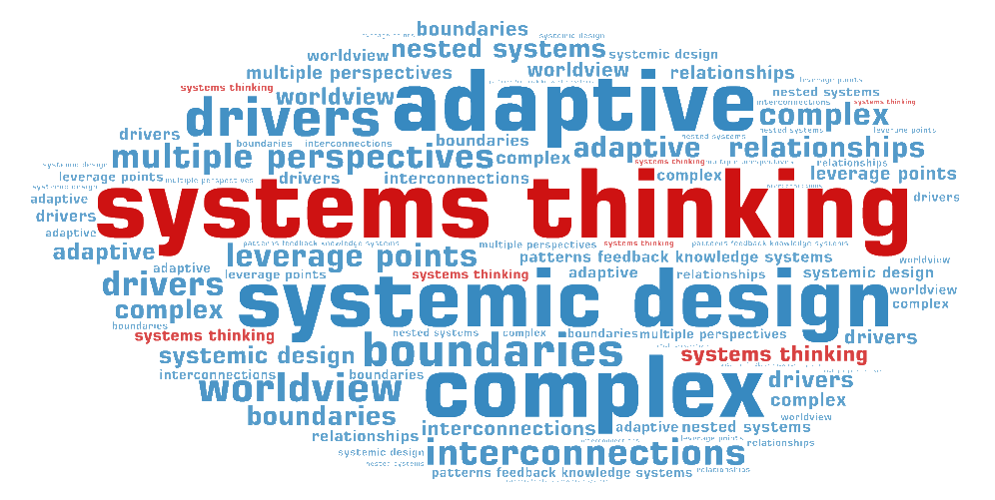
An introduction to systems thinking and tools for systems thinking
- it’s a way of collaboratively talking about and designing real-world solutions
Will Allen & Margaret Kilvington

Slide 2
Content guide
Introduction: Why decision-makers are moving towards a systems thinking approach to better deal with complex situations in health, environment, education, etc.
Basics of systems thinking
Systemic design – linking systems thinking and design
Introduction to range of tools/methods that support systems thinking and systemic design in practice
Nurturing & supporting systems thinking in your practice
Reference as: Allen & Kilvington (2018) An introduction to systems thinking and tools for systems thinking (Presentation). Available online https://learningforsustainability.net/wp-content/uploads/2019/01/Intro-systems-thinking-and-systemic-design-concepts-and-tools.pdf

Slide 3
1. Why the growing interest in a systems thinking approach

Slide 4
We are all systems thinkers
We all grew up exploring our natural and social worlds and asking questions born of curiosity. We can look at problems, see beyond the obvious, and explore otherwise hard to see connections.
But in many school and workplace settings today knowing the “right answers” is often rewarded over systems-based inquiry and creativity.
Yet in today’s more crowded, and rapidly changing, world there are fewer instances where all that is needed is a “right answer” – rather there are more perspectives, interconnections and interdependencies to consider!
Hence the growing interest in learning to strengthen systems thinking practices, and manage organisational cultures that encourage its use in both problem structuring and solution design.

Slide 5
Systems thinking enables us to:
Change our thinking to match the interconnected, dynamic complexity of our communities and their environments
Communicate with others to create new ways of thinking and seeing - and develop shared understanding
Change our behaviour to work with the complex forces in the system (instead of against them) to realize our vision
Identify and test a wider variety of possible actions and solution pathways
Become more aware of the potential for unintended consequences of our actions
Harness social learning processes to help us develop a shared understanding and take action collectively
Expand the choices available to us and identify those choices where we can develop significant leverage

Slide 6
Of course - not all systems are the same!
There are different kinds of systems
Simple / complicated
Complex and adaptive
We need to understand them, and use different management styles for each
Image: Land Information New Zealand
6
Notes:
What we do see from thinking about different land enterprises in terms of their different outcomes is that there are a number of very different problems and systems set out there.
Again given that it is unlikely that one size fits all, so it becomes important to look at these systems and see how they differ .... And what such differences might mean for management. In much of the management literature reviewers are suggesting that it is useful to look at systems being either simple, complicated or complex and adaptive.

Slide 7
A typology of problem situations
Far from
Complex “wicked” problems
Agreement
Complicated “difficult” problems
Close to
Simple problems
Close to
Certainty
Far from
Modified from work by Ralph D. Stacey and Dave Snowden

Slide 8
Difficult problems
Limited timescale
Priorities clear
Recognisable solution
Limited applications
Know what needs to be done
Limited number of people involved
Can be treated as a stand-alone matter
Difficult problems are characteristically smaller-scale and well-defined

Slide 9
Wicked problems
Longer, uncertain timescale
Priorities called into question
No ‘obvious” solutions
Uncertain, but greater implications, worrying
No agreement on what the problem is
Can’t be disentangled from its context
More people involved
Keep evolving
Wicked (or complex) problems are characteristically bigger and poorly-defined

Slide 10
International agencies and public sector organisations are moving towards systems thinking …..

Slide 11
International agencies and public sector organisations are moving towards systems thinking …..
… to deal with complex or ‘wicked’ problems which
go beyond range of any one organization to manage them
are often characterised by disagreement about causes, and how to tackle them
recognise the need to change behaviour or practice at multiple levels and scales (individuals to organizations)
require innovative solutions that can be adapted in the light of experience and feedback

Slide 12
Different systems require different management
Managing a complicated system
Managing a complex adaptive system
Develop explicit plans
Plan then act
Look for agreement & clear outcome
Limit types of approaches & actions
Set targets
Drive implementation
Look for divergence
Act, learn, and plan at the same time
Use minimum specifications
Work on multiple leverage points
Be creative with opportunities at the boundaries
Build on what emerges and grows
From:
Complicated or complex – knowing the difference is important
Notes:
What this means is that each system type requires different management paradigms.
Managing a complicated system requires developing specific blueprints, looking for clear outcomes, and limiting the types of approaches and actions that have to be taken. The emphasis is on efficiency and streamlining the delivery of the operation.
In contrast managing a complex adaptive system is more about using minimum specifications and looking to encourage learning and innovative solutions. Monitoring and adapting becomes the key to moving forward. Because each player and groups of players are different it becomes important to work with multiple leverage points for change. Its important to build on what emerges ... Different groups will be ready to do different things at different times.

Slide 13
2. Basics of systems thinking

Slide 14
World views
Interconnections
Multiple
Perspectives
Voices
Relationships
Patterns
Knowledge systems
Feedback
Key systems thinking
components
Communities
Blocks
Boundaries
Scope
Influences
Issues
Systems within systems
Leverage points
Drivers

Slide 15
Multiple Perspectives
Who or what are the key stakeholders in this situation?
What stakes (individual values and motivations) do they have?
What are the different ways in which the situation can be framed or understood – by whom?
How do these different framings affect the way in which stakeholders act – when things go their way/when things don’t go their way?

Slide 16
Interconnections
How do the elements within the situation (components, stakeholders, knowledge, etc.) interconnect?
What is the nature of the relationships between them (e.g. strong/weak, fast/slow, collaborative, direct, indirect, etc.)?
What patterns emerge from these relationships in action - with what consequences, and for whom?

Slide 17
Boundaries
Define scope and scale (and from what/whose perspective is this developed.)
Are other boundaries possible – and feasible?
Agree on how to structure the problem situation
Discuss what constitutes an improvement – and how this might be different for different stakeholders?

Slide 18
Influences
What drives the systems in question in particular directions
Identify …. drivers, trends, enablers, blocks, leverage points
Leverage points are seen as key points with which to intervene in complex systems

Slide 19
The iceberg model for systems thinking
VISIBLE
Events
Increasing leverage
Patterns & trends
System structures & drivers
RARELY SEEN
Predominant social paradigm
(Mental models, worldviews)
Transformational change
The iceberg model is a systems thinking tool designed to help an individual or group discover the patterns of behaviour, supporting structures, and mental models that underlie a particular event.
From: Systems thinking: what, why when, where and how ~ by Michael Goodman 1997

Slide 20
Some questions to help unpack the system
PRESENT
What is the fastest way to react to this event NOW?
Events
What trends and/or patterns are occuring?
Patterns & trends
What mental/organizational structures create the patterns?
System structures & drivers
What are the stated/unstated visions that generate this structure?
Predominant social paradigm
(Mental models, worldviews)
FUTURE

Slide 21
Donella Meadows’ 12 leverage points: places to intervene in a system
Numbers
Buffers
Stock and flow structures
Delays
Balancing feedback loops
Reinforcing feedback loops
Information flows
Rules
Self-organization
Goals
Paradigms
Transcending Paradigms
Increasing leverage
From: Leverage points – places to intervene in a system by Donella Meadows

Slide 22
3. Systemic design – linking systems thinking and design

Slide 23
Linking systems thinking and design
Systems thinking
Design thinking
Problem framing
+
Solution oriented
Systemic design - integrating the mindsets and toolsets of systems thinking and design thinking to encourage learning and innovative systems change
For more information:
Systemic design

Slide 24
Systemic design
These frameworks link together to support collaborative decision-making. For example key functions in a typical adaptive management/policy setting process may include:
[Systems thinking] Involving participants in understanding issue and wider context (recognizing different perspectives/problem structuring, potential leverage points)
[Design thinking] Jointly develop action plans (identify activities, outcomes, and assumptions) and M&E plans
[Reflective thinking] Learn and refine (adaptive management)
For more information:
Systemic design
Notes:
Thinking of the ‘big picture” - Whatever problem is being faced is attached to a larger system. To discover the source of the problem we have to widen our focus, and it is from that perspective we will likely find a systemic solution.

Slide 25
Tools/methods for systems thinking and systemic design can be grouped by function
Understanding the system
Co-designing solutions
Monitor, reflect and adapt
Dialogue and collaboration
The first three functions essentially can be seen as linked elements in an iterative and experiential learning cycle – in a systems approach each is best carried out using tools that support dialogue and collaboration among the stakeholder groups involved.
25

Slide 26
Tools/methods for systemic design
- supporting an experiential learning cycle
Understanding the system
Boundaries
+
Influences
Interrelationship
Leverage points
Action plans
Dialogue & collaboration
Co-design solutions
Short term and long term goals
Choose indicators
Refine
Assess and adapt
Managing conflict
Multiple perspectives
Assess progress
monitor
Recognising different knowledge systems and cultures
Implementation by organizations, other key stakeholders

Slide 27
4. Tools and methods for systems thinking and systems design
There are so many!

Slide 28
“All tools are wrong. Some tools are useful.”
“Over the years, I’ve found that starting with methods, whether causal loop diagrams or Soft Systems Methodology or Social Network Analysis, often confuses or exasperates novices ….
… furthermore, no single method will equip them with the power of the systems field.”
~ Bob Williams
https://thesystemsthinker.com/%EF%BB%BFall-methods-are-wrong-some-methods-are-useful/

Slide 29
Important to see how sets of tools/methods fit in the bigger process in which they are used
Understanding the system
Boundaries
+
Influences
Interrelationship
Leverage points
Action plans
Dialogue & collaboration
Co-design solutions
Short term and long term goals
Choose indicators
Refine
Assess and adapt
Managing conflict
Multiple perspectives
Assess progress
monitor
Recognising different knowledge systems and cultures
Implementation by organizations, other key stakeholders

Slide 30
1. Tools for understanding the system
1
Understanding the system
+
Influences
Boundaries
Interrelationship
Leverage points
Action plans
Dialogue & collaboration
Co-design solutions
Choose indicators
Short term and long term goals
Refine
Assess and adapt
Managing conflict
Multiple perspectives
Assess progress
monitor
Recognising different knowledge systems and cultures
Implementation by organizations, other key stakeholders

Slide 31
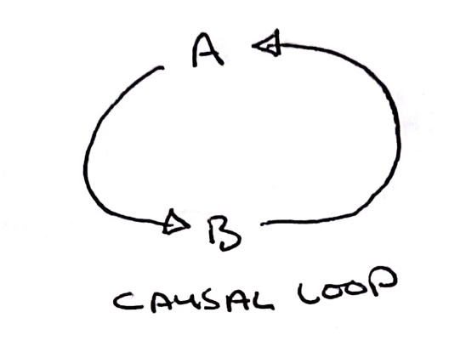
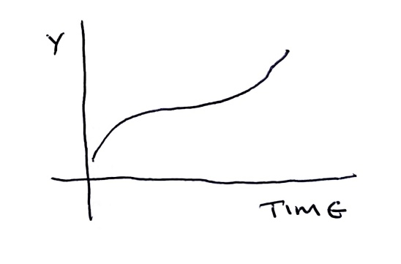
1. Understanding the system - tools for seeing things
Timelines
Trend analysis
System archetypes
Rich pictures
Cynefin framework/Stacey diagram
Concept mapping
Social network analysis
Causal loop diagrams
Bayesian belief networks
Computer models
etc
For more information:
Systems methods and tools

Slide 32
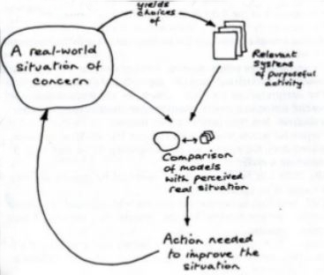
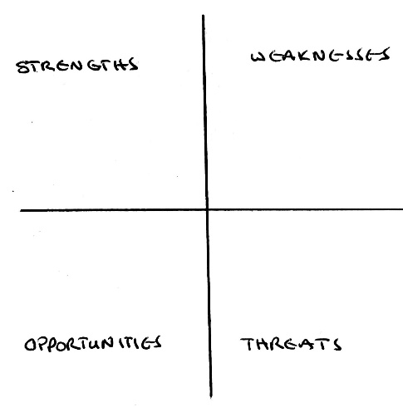
Understanding the system - tools for thinking strategically
CATWOE
Iceberg model
System archetypes
Soft Systems Methodology (SSM)
Scenarios and visioning
Problem structuring methods
SWOT/TOWS analysis
STEEP (PEST, PESTLE, STEP, etc.)
etc
For more information:
Strategy tools and approaches

Slide 33
2. Tools for dialogue and collaboration
2
Understanding the system
Boundaries
+
Influences
Interrelationship
Leverage points
Action plans
Dialogue & collaboration
Co-design solutions
Short term and long term goals
Choose indicators
Refine
Assess and adapt
Managing conflict
Multiple perspectives
Assess progress
monitor
Recognising different knowledge systems and cultures
Implementation by organizations, other key stakeholders

Slide 34
Dialogue & collaboration – tools for involving the right people include:
Stakeholder analysis
Engagement planning
Networking
Relationship building & management
Not just who you could get to come at the time
Source: http://weird-vintage.com
For more information:
Stakeholder mapping and analysis

Slide 35
Dialogue & collaboration – tools for working together
Use multiple methods and always have a plan. Tools include:
Facilitation
Kitchen workshops and meetings
Informal conversations
Networks
Social media
Active listening, appreciative inquiry ...
Don’t travel the same road every time
Source: www.pexels.com
For more information:
Using dialogue and negotiation

Slide 36
3. Tools for co-designing solutions
Understanding the system
Boundaries
+
Influences
Interrelationship
Leverage points
Action plans
Dialogue & collaboration
Co-design solutions
Short term and long term goals
Choose indicators
Refine
Assess and adapt
Managing conflict
Multiple perspectives
Assess progress
monitor
Recognising different knowledge systems and cultures
3
Implementation by organizations, other key stakeholders

Slide 37
Tools for co-design – finding desirable solutions
Usually both a product and a process. Approaches include:
Agile planning (scrums & sprints) …. as opposed to waterfalls
The five stages of Design Thinking (Empathise, Define – the problem, Ideate, Prototype, and Test)
Along with a whole host of methods …. problem structuring methods (PSMs), conceptual models, scenario development, (participatory) system dynamic modelling and simulation, etc.

Slide 38
Tools for co-design – outcomes modelling [Theory of Change (ToC) and logic models]
Situation analysis
Inputs, activities & outputs
Outcomes
Vision
For more information:
Theory of Change and logic models

Slide 39
… can account for acknowledgement that people and organisations need to change first
Situation analysis
Inputs, activities & outputs
Outcomes
Outcomes - Impact
Intermediate Long-term
Changes - in individuals & organisations
Vision
Changes in practice
Changes in end states

Slide 40
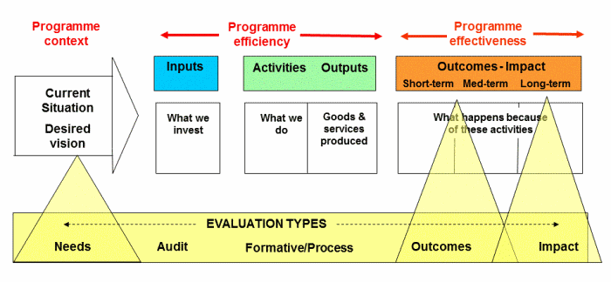
… and helps develop monitoring and evaluation plans along with activity plans
For more information:
Planning, monitoring & evaluation – closing the loop

Slide 41
4. Tools/methods for assessing progress
Understanding the system
Boundaries
+
Influences
Interrelationship
Leverage points
Action plans
Dialogue & collaboration
Co-design solutions
Short term and long term goals
Choose indicators
Refine
Assess and adapt
Managing conflict
Multiple perspectives
Assess progress
monitor
Recognising different knowledge systems and cultures
4
Implementation by organizations, other key stakeholders

Slide 42
Tools for assessing and adapting include:
Theory of change and accompanying logic models
Complexity-aware monitoring (outcomes mapping, MSC, etc.)
Using rubrics to assess complex tasks and behaviours (intermediate outcomes)
Facilitating reflective practice (After Action Reviews – AARs and Strategic Learning Debriefs
For more information:
Planning, monitoring & evaluation – closing the loop
42

Slide 43
5. Embedding systems thinking in practice

Slide 44
It is important to create a learning organisation where:
people continually expand their capacity to create the results they truly desire
new and expansive patterns of thinking are nurtured
collective aspiration is set free … and
people are continually learning to see the whole together.
~ Peter Senge 1990 – The Fifth Discipline

Slide 45
Common challenges that often have to be faced include
The perception that learning (collaboration and dialog) takes too long
Too few people with the skillsets and resources required to follow through
Exploring one’s personality and goals in a group can sometimes seem threatening and daunting
A lack of safe spaces for groups to work in this different way
A lack of formal commitment to the process from organisational leadership

Slide 46
Senge: the five core disciplines required for a successful learning organization
Systems Thinking
Personal Mastery
Mental Models
Building Shared Vision
Team Learning
Image source: Peter Senge Systems Thinking

Slide 47
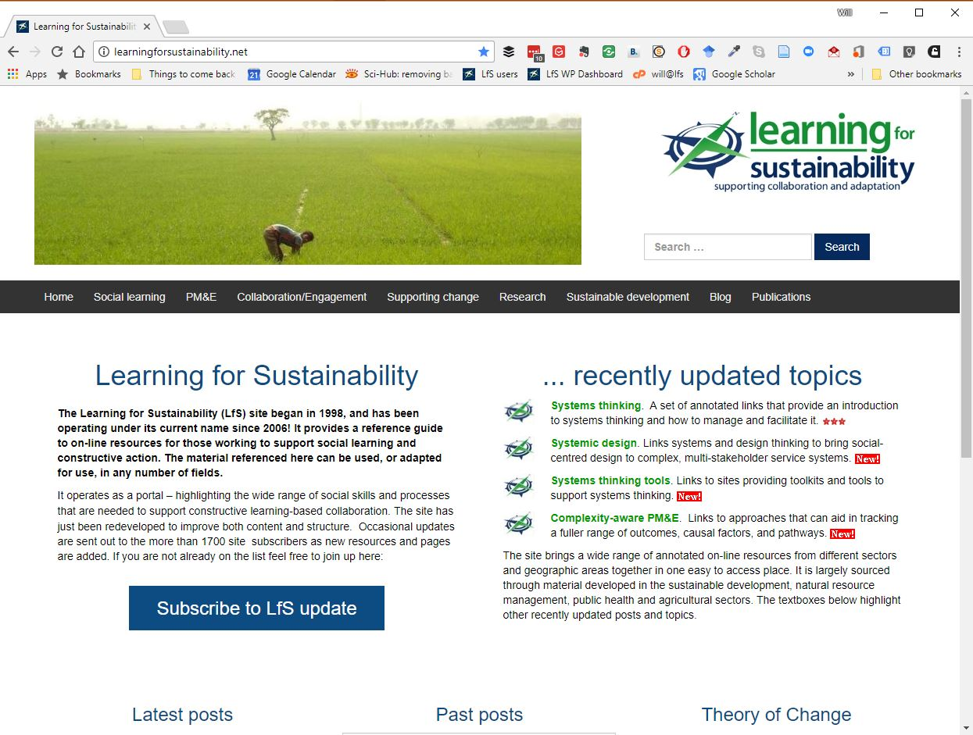
For more information visit: http://learningforsustainability.net
47

Slide 48
For more information
Dr Margaret Kilvington – margaret.kilvington@gmail.com
- Independent Social Research, Evaluation & Facilitation
Dr Will Allen – willallennz@gmail.com
- Will Allen & Associates / Learning for Sustainability
Annotated links to a wide range of related on-line material can be found via the Learning for Sustainability clearinghouse - https://learningforsustainability.net/
Reference as: Allen & Kilvington (2018) Summary: An introduction to systems thinking and tools for systems thinking (Presentation). Based on material for a Greater Wellington Regional Council introductory systems thinking workshop, Wellington, New Zealand. Available online https://learningforsustainability.net/wp-content/uploads/2019/01/Intro-systems-thinking-and-systemic-design-concepts-and-tools.pdf

